Slide 1

Grocery Store Management
Batch 484
G. Uttej Reddy
M. Kishore Reddy

Slide 2
About me
G. Uttej Reddy
Pursuing B.Tech (IT) at Anurag University
Interested in Data Analytics to analyze data, solve real-world problems, and make smart decisions using technology
LinkedIn: www.linkedin.com/in/gangireddy-uttej-reddy-12376029b
GitHub: https://github.com/Gangireddy-uttej-reddy
M. Kishore Reddy
Pursuing B.Tech (IT) at Anurag University
Interested in Data Analytics because it combines programming, analytics, and business insights to create impactful solutions
LinkedIn: http://www.linkedin.com/in/mandadi-kishore-reddy-bb243a287
GitHub: https://github.com/kishore-345

Slide 3
Agenda
Business Problem
Problem Statement
Objective
ER Diagram
Queries
Conclusion
Recommendation
Q/A
Thank you

Slide 4
Business Problem
Grocery stores often face challenges in managing inventory, customer orders, product sales, suppliers, and employee activities efficiently. Manual tracking of these operations can lead to inaccurate billing, stock shortages, poor sales analysis, and difficulty in monitoring business performance. The lack of a centralized system makes it hard to identify top-selling products, customer purchasing patterns, revenue trends, and employee performance.

Slide 5
Problem Statement
The Grocery Store Management System aims to develop a relational database system that stores and manages data related to customers, products, suppliers, employees, and orders. The project focuses on using SQL queries to analyze sales, customer behavior, product performance, supplier contribution, and operational efficiency to support better business decision-making.

Slide 6
Objective
Design and implement a relational database for grocery store operations
Manage products, suppliers, customers, employees, and orders efficiently
Analyze customer purchasing behavior and sales trends
Identify top-selling products and high-value customers
Evaluate supplier and employee performance
Generate business insights using SQL concepts like joins, aggregations, subqueries, and filtering techniques

Slide 7
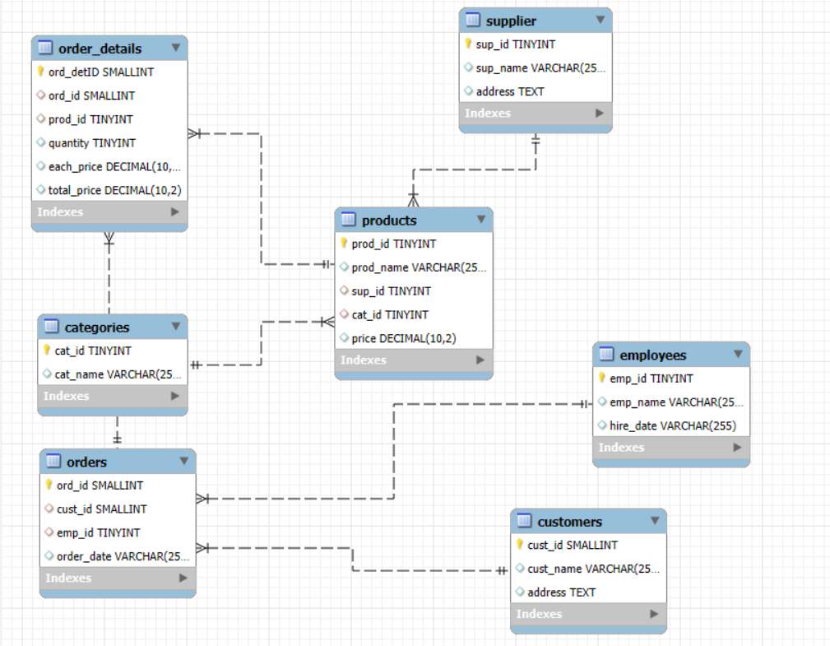
ER Diagram
One-to-Many from Customers to Orders
One-to-Many from Employees to Orders
One-to-Many from Orders to Order Details
One-to-Many from Products to Order Details
One-to-Many from Suppliers to Products
One-to-Many from Categories to Products

Slide 8


Queries
How many unique customers placed orders?
Counts the total number of unique customers who have placed orders in the store.

Slide 9
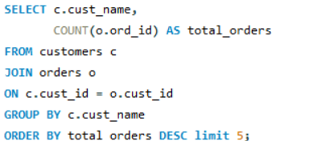
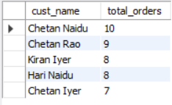
Queries
Which customers placed the highest number of orders?
Identifies customers who have placed highest number of orders in the grocery store.

Slide 10
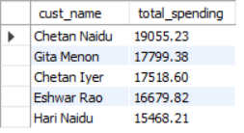
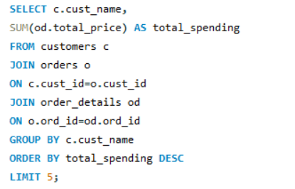
Queries
Top 5 Customers by Spending
Identifies the top 5 customers with the highest total spending in the grocery store.

Slide 11
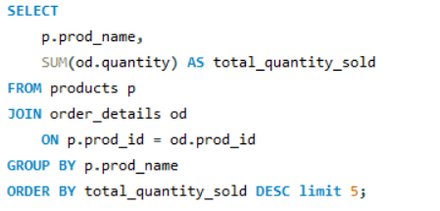
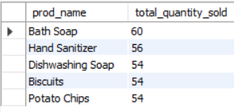
Queries
Products with Highest Sales Quantity
Identifies the products with the highest sales quantity to determine best-selling items.

Slide 12
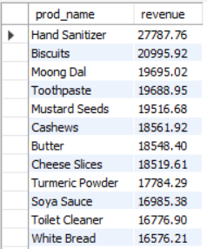
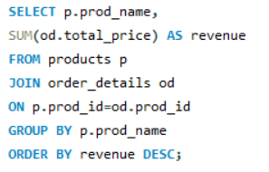
Queries
Revenue Generated by Each Product
Calculates the total revenue generated by each product based on sales transactions.

Slide 13
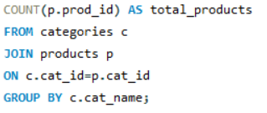
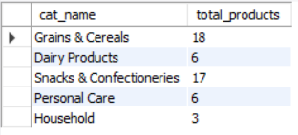
Queries
Category Wise Product Count
Displays the total number of products available in each product category.

Slide 14
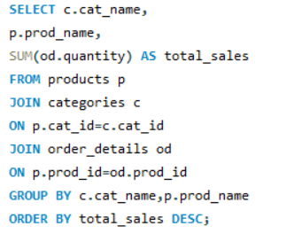
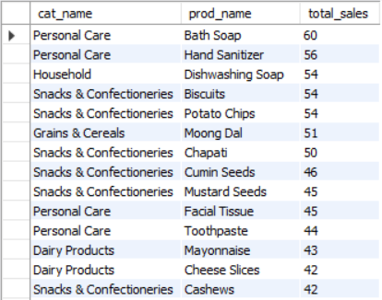
Queries
Top Product in Each Category
Identifies the highest-selling product in each product category.

Slide 15
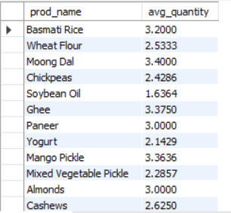
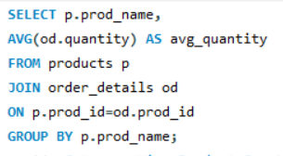
Queries
Average Quantity Ordered Per Product
Calculates the average quantity ordered for each product based on customer purchases.

Slide 16
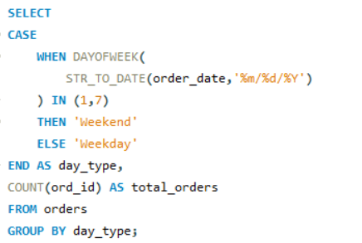

Queries
How do order patterns vary across weekdays and weekends?
Weekday orders are higher than weekend orders, indicating increased customer shopping activity during weekdays.

Slide 17
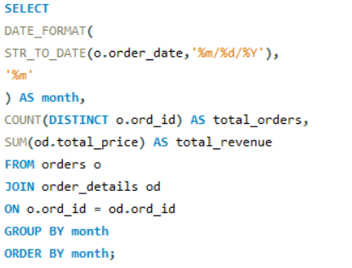
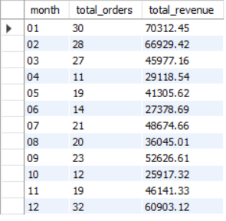
Queries
What are the monthly trends in order volume and revenue?
Order volume and revenue fluctuate across months, with January showing the highest sales performance and October recording the lowest.

Slide 18
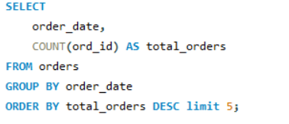
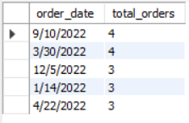
Queries
On which dates were the most orders placed?
Dates with the highest number of customer orders placed.

Slide 19
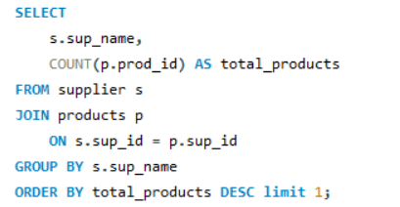

Queries
Which supplier provides the most products?
Supplier contributing the highest number of products to the inventory.

Slide 20
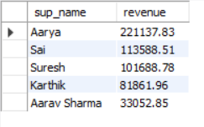
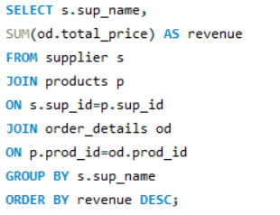
Queries
Supplier with Highest Revenue
Identifies the supplier contributing the highest total revenue through product sales.

Slide 21
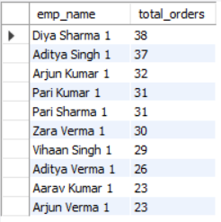
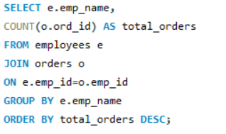
Queries
Employee Handling Most Orders
Identifies the employee who handled the highest number of customer orders.

Slide 22
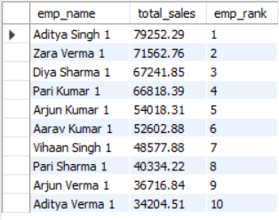
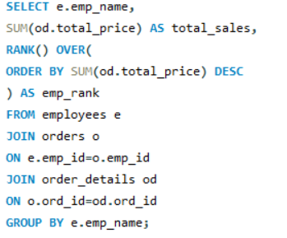
Queries
Rank Employees by Sales
Ranks employees based on the total sales value they processed.

Slide 23
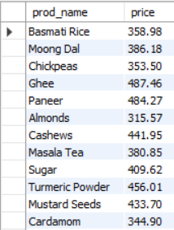
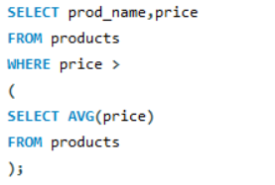
Queries
Products Above Average Price
Identifies products priced higher than the average product price in the store.

Slide 24
Conclusion
Top customers contribute a significant portion of total revenue.
Certain products and categories consistently generate higher sales.
Weekday order volume is higher compared to weekends.
Some suppliers contribute more revenue than others.
Employee performance varies based on order handling and sales value.

Slide 25
Recommendations
Focus on retaining high-value customers through loyalty programs.
Maintain higher inventory for top-selling products.
Increase promotions during high-sales periods.
Strengthen partnerships with high-performing suppliers.
Provide incentives for top-performing employees.
Monitor low-performing products and optimize pricing strategies

Slide 26

THANK YOU

